Slide 1
ECE 313: PROBABILITY WITH ENGINEERING APPLICATIONS
Fall 2023
Prof. Eric Chitambar
Lecture 3

Slide 2
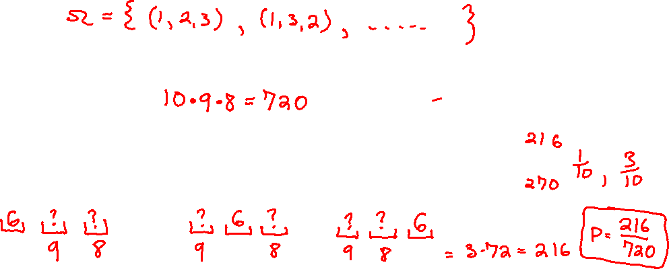
Example Problem

Slide 3
Tips for Counting

Slide 4

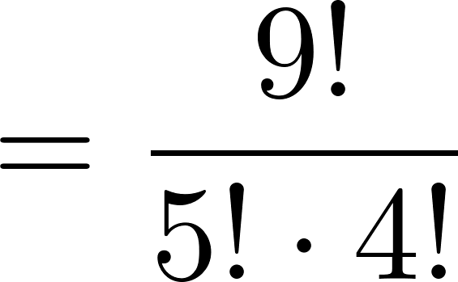
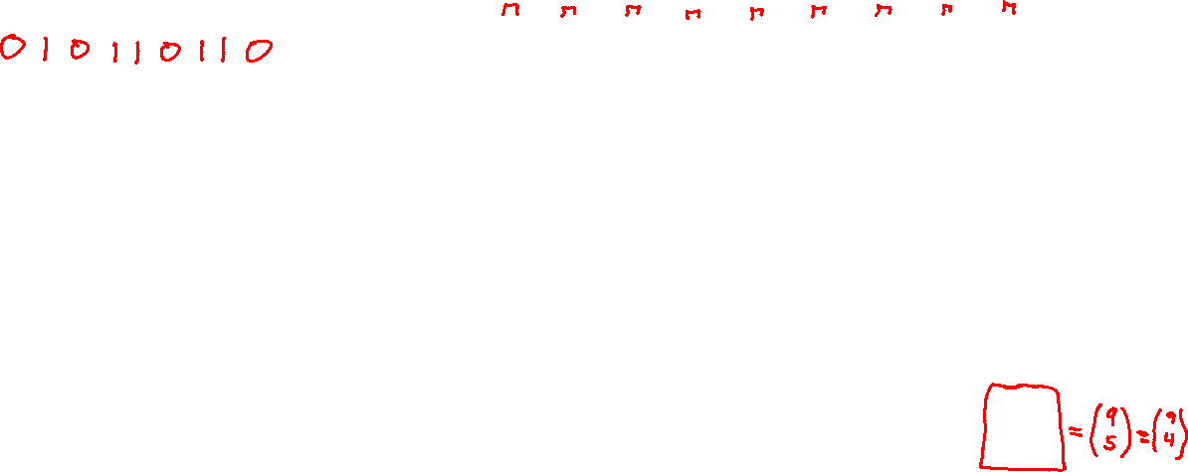
Tips for Counting

Slide 5
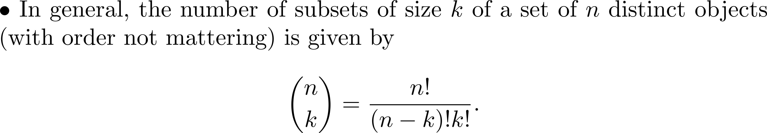
Tips for Counting

Slide 6
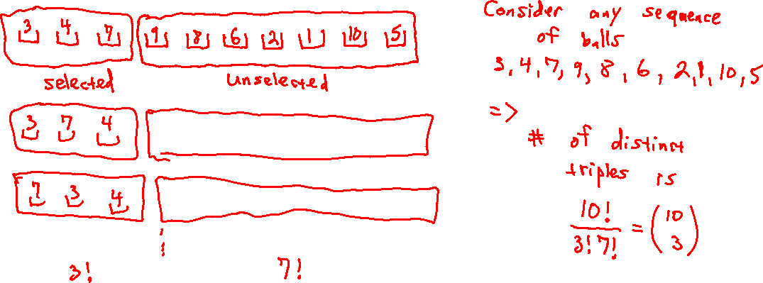
Return to the Example Problem..

Slide 7
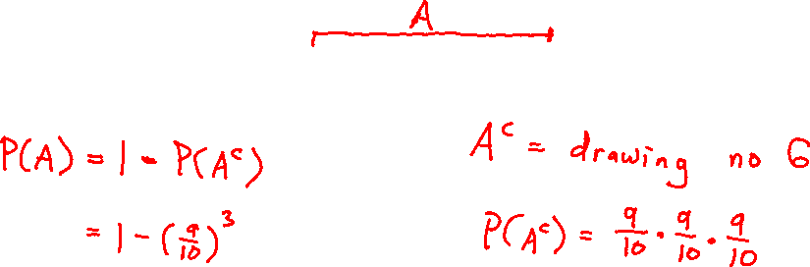
Return to the Example Problem..

Slide 8
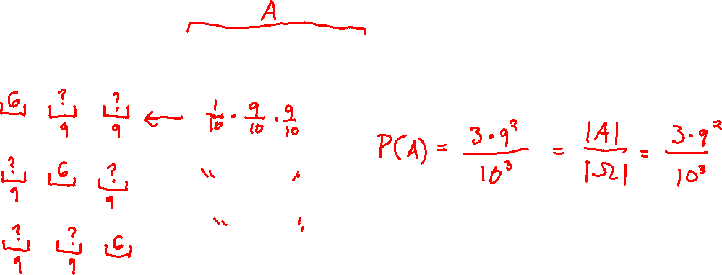
Return to the Example Problem..

Slide 9
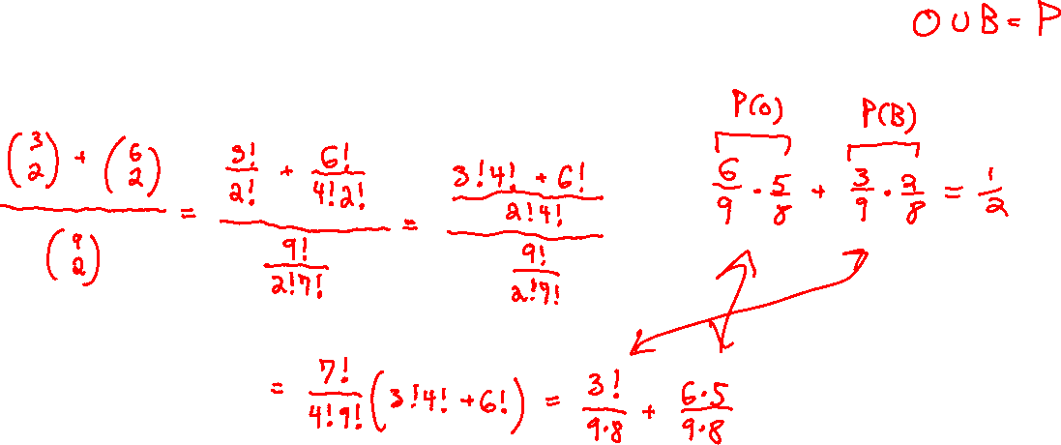
Example

Slide 10
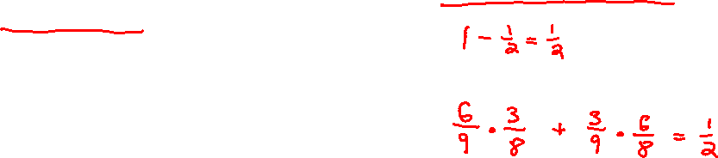
Example

